Slide 1
Bem József

Slide 2
Bem József

Slide 3
His life
Józef Zachariasz Bem, also called Murad Pasha, Polish army general whose military feats in Transylvania and the region of Banat made him a hero of the Hungarian Revolution of 1848–49. He was the author of treatises on artillery, mathematics, and history.

Slide 4
His activities
In 1848 he offered his services to the Hungarian leader Lajos Kossuth and was assigned the defense of Transylvania. With a small army he performed prodigiously against the Austrians, especially in his stand at the bridge of Piski (1849), where he repulsed superior forces. Bem occupied the Banat region but had to return to the defense of Transylvania when the Russians invaded. Finally, on July 31, overwhelming forces wiped out his army. Bem escaped only by feigning death.

Slide 5
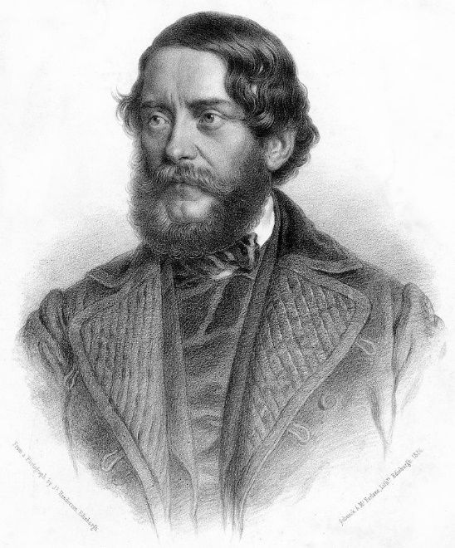
Lajos Kossuth

Slide 6
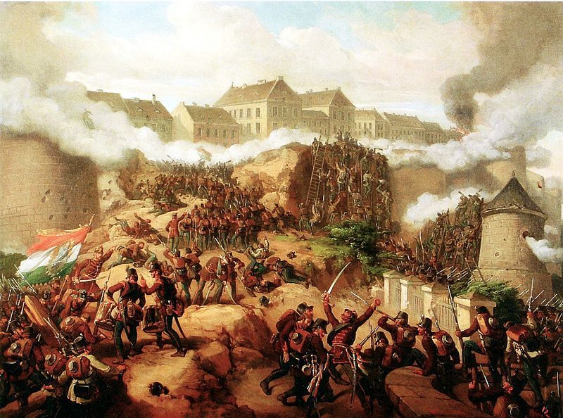
Hungarian Revolution (1848)

Slide 7
Battle of Pákozd (29 September 1848)

Slide 8
Thank you for the attention. Made by:
Mathey Levente
Giraczi Benjamin
Karol Dudek

