Slide 1
Józef Bem
Polish and Hungarian hero

Slide 2
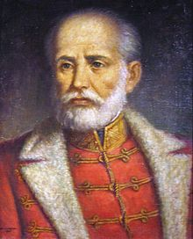
Polish: Józef Zachariasz Bem
Hungarian: Bem József
Bem was born in Tarnów in Galicia, the area of Poland that had become part of the Habsburg Monarchy through the First Partition in 1772. He was a Polish engineer and general, an Ottoman pasha and a national hero of Poland and Hungary.

Slide 3
Poland

Slide 4

November Uprising
When the November Uprising, a struggle for Polish independence, broke out on November 29, 1830, against the Russian Empire, Bem immediately joined the Polish insurgents. he led during the Battles of Iganie and Ostrołęka. Although the Polish army suffered a serious defeat with a loss of 6,000 men, Bem's actions prevented the destruction of the entire army. For his valour on the battlefield, Bem was awarded the Virtuti Militari Golden Cross and promoted to the rank of Brigadier General.

Slide 5
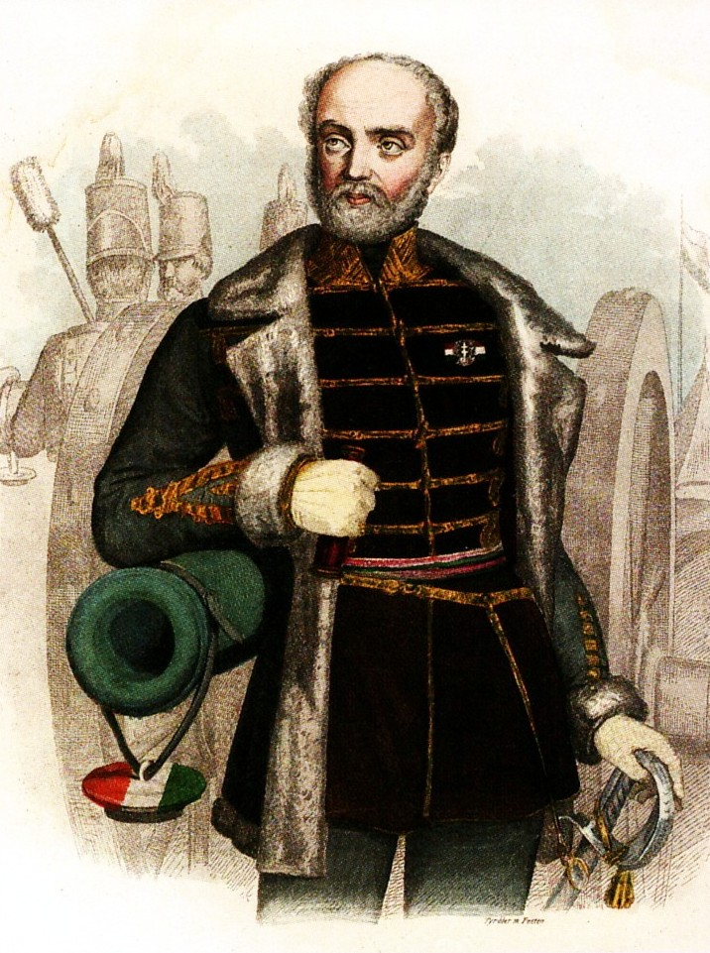
Exile
Bem then escaped to Paris, where he supported himself by teaching mathematics. In France, he published his next work, on the National Uprising in Poland, in which he not only gave an appraisal of the 1831 insurrection, but also tried to present a programme for the continuation of the struggle for the country's freedom.
In 1833 he went to Portugal to assist the liberal Dom Pedro against the reactionary Dom Miguel, but abandoned the idea when it was found that a Polish legion could not be formed there. When in Portugal, he was the target of an assassination attempt, carried out by Russian agents.

Slide 6
Hungary

Slide 7
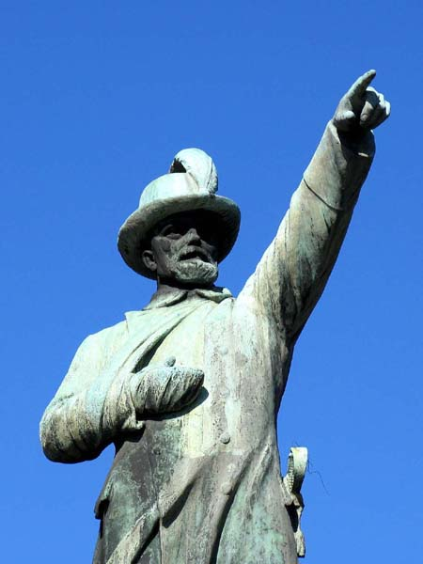
Liberating Transylvania
The armed campaign held from December 1848 to March 1849. The most famous battle was in Piski.

Slide 8
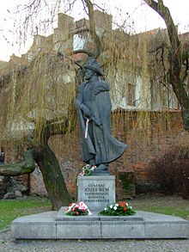
Second Exile
On the collapse of the rebellion he fled to the Ottoman Empire, where he adopted Islam,[1] and served as Governor of Aleppo under the name of Murad Paşa/Pasha

Slide 9
Thanks for your attention!
Katona Alexandra, Adrian Kołcz, Dawid Gemra

