Slide 1
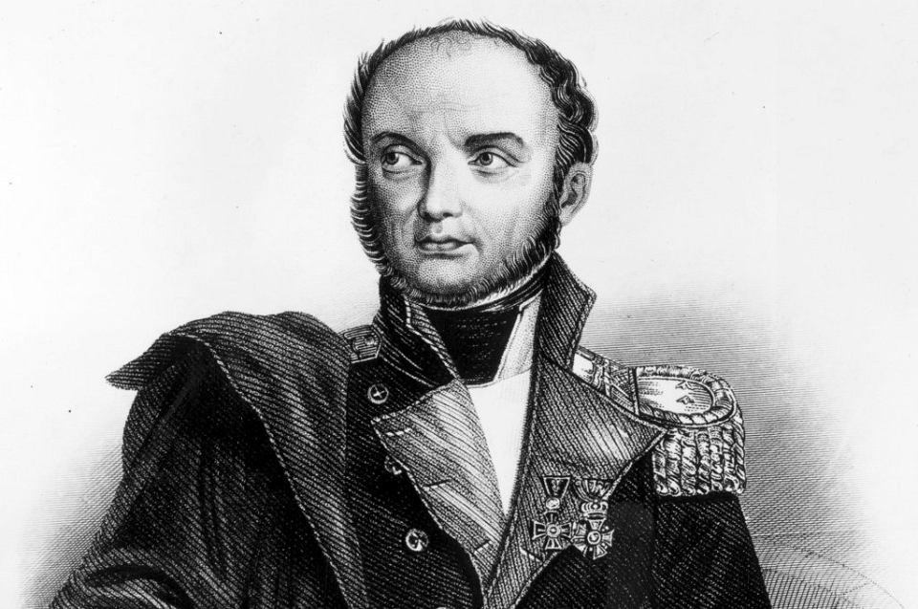
Józef Bem Biography

Slide 2
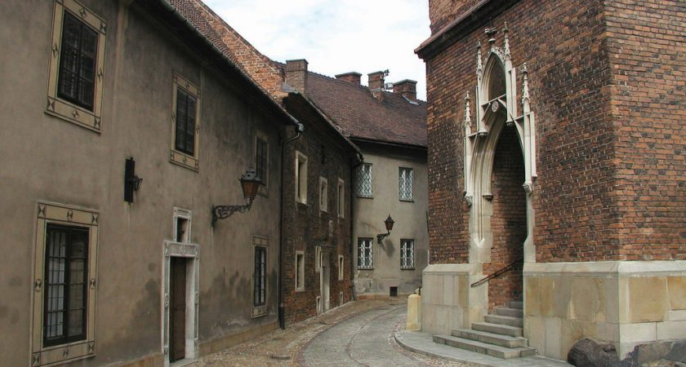
Youth of Józef Bem
Bem was born in Tarnów in Galicia, the area of Poland that had become part of the Habsburg Monarchy through the First Partition in 1772. After the creation of the tiny Duchy of Warsaw from the territories captured by Napoleon, he moved with his parents to Kraków, where after finishing military school (where he distinguished himself in mathematics) and joined the ducal forces as a fifteen-year-old cadet. Bem joined a Polish artillery regiment as a sub-lieutenant and then lieutenant in the French service, took part in the French invasion of Russia (1812), and subsequently distinguished himself in the defence of Danzig (Polish: Gdańsk) (January – November 1813), winning the Knight's Cross of the Legion d'honneur.

Slide 3
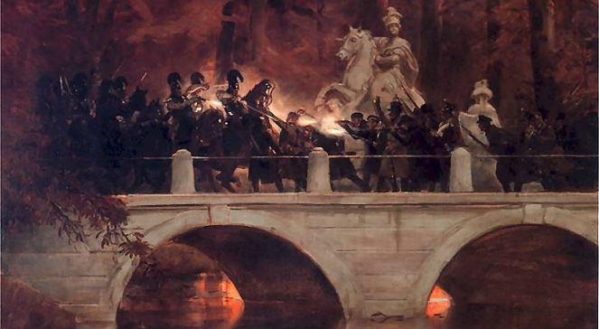
November Uprising
When the November Uprising, a struggle for Polish independence, broke out on November 29, 1830, against the Russian Empire, Bem immediately joined the Polish insurgents. He arrived in Warsaw, was given a major's commission and the command of the 4th Light Cavalry Battalion, which he led during the Battles of Iganie and Ostrołęka. During the Battle of Ostrołęka,
Bem's forces bravely charged the Russian opponents.
Although the Polish army suffered a serious defeat
with a loss of 6,000 men, Bem's actions prevented
the destruction of the entire army. For his valour
on the battlefield, Bem was awarded the Virtuti
Militari Golden Cross and promoted to the rank of Brigadier General.

Slide 4
1848 hero
After relieving Transylvania he was sent to drive the Austrian General Anton Freiherr von Puchner out of the Banat region. Bem defeated him at Orşova on May 16, but the Russian invasion forced him to retreat to Transylvania. From July 12 to 22 he was fighting continually, but finally, on July 31, his army was annihilated by overwhelming numbers in the Battle of Segesvár (near Segesvár, now Sighişoara, Romania), Bem escaping only after feigning death. Yet he fought a fresh action at Nagycsür (now Romanian: Sura Mare, Romania) on August 6, and contrived to bring his fragmented army to the Battle of Temesvár (near Temesvár, now Timişoara, Romania), to aid the hard-pressed General Henryk Dembiński. Bem was in command and was seriously wounded in the last pitched battle of the war, fought there on August 9.

Slide 5
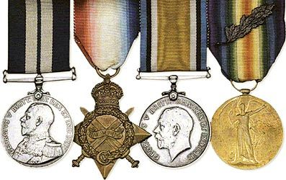
Honors
Three commemorative postage
stamps were issued on 10 December
1950 by Hungary on account of his
death centenary.
A souvenir sheet was issued on 10
December 1950 by Hungary on Stamp
Day.
On 15 March 1952 his stamp appears in
Heroes of the 1848 Revolution series.
Poland issued a commemorative postage
stamp on 15 July 1948 in Revolution Centenaries series.
Poland issued postage stamp on 10
December 1950 on his death centenary.

Slide 6
The presentation has been made by :
-Lexi
-Zsani
-Patryk

