Slide 1
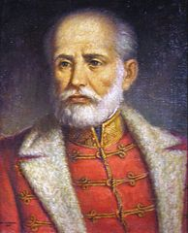
Józef Bem
Juhos Fanni
Sass Bence
Damian Kobyliński

Slide 2
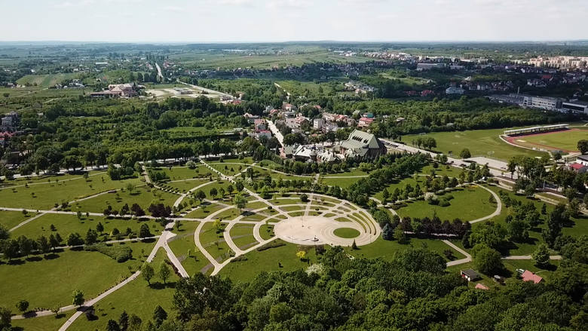
First footsteps
Born in Busku (near Tarnów) at 1794. When he was a young child, his mother died. He had six siblings. His father was wealthy counsel.

Slide 3
His army career
He is a national Hungary and Polish hero. Commandor of Hungarian Revolution in 1848 and also commandor of November Upring in 1830-1831. He helped Austria from imperial troops of Alfred I – Prince of Windisch-Grätz. He created two emigration organizations:
Literary and History Society,
Politechnical Polish Society in Paris

Slide 4
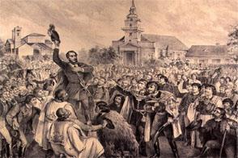
Hungarian Revolution
It started in 13 december 1848. All nation was involved to fight with Austria occupation. Józef Bem gave from the goverment huge amount of soldieries. Many of the important fights in Revolution he and his army won. Unfortunately Hungary lost all revolution – He was ingured in the Battle of Temesvár.

