Slide 1
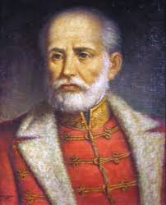
Jozsef Bem
1794-1850

Slide 2
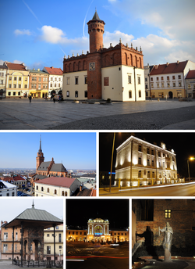
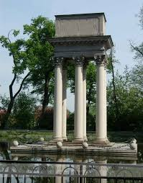
Early life
Bem was born in Tarnów in Galicia
He moved with his parents to Kraków, where after finishing military school and joined the ducal forces as a fifteen-year-old cadet.
Bem became a teacher at a military college. There he carried out research on a newly designed rocket-like missile, publishing his research with extensive illustrations.

Slide 3
TARNów
Tarnów is a city in southeastern Poland with 109,650 inhabitants and a metropolitan area population of 269,000 inhabitants. The city is situated in the Lesser Poland Voivodeship since 1999. From 1975 to 1998, it was the capital of the Tarnów Voivodeship. It is a major rail junction, located on the strategic east–west connection from Lviv to Kraków, and two additional lines, one of which links the city with the Slovak border. Tarnów is known for its traditional Polish architecture, which was strongly influenced by foreign cultures and foreigners that once lived in the area, most notably Jews, Germans and Austrians.[1] The entire Old Town, featuring 16th century tenements, houses and defensive walls, has been fully preserved. Tarnów is also the warmest city of Poland, with the highest long-term mean annual temperature in the whole country

Slide 4
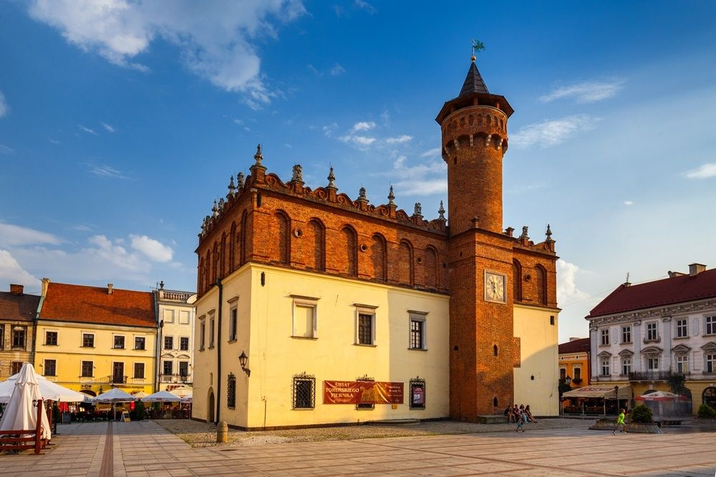
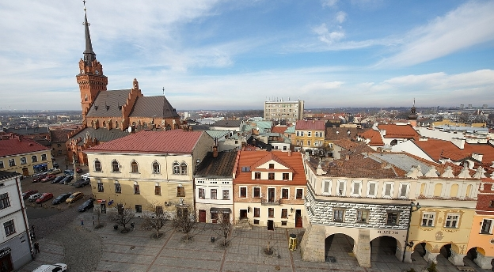
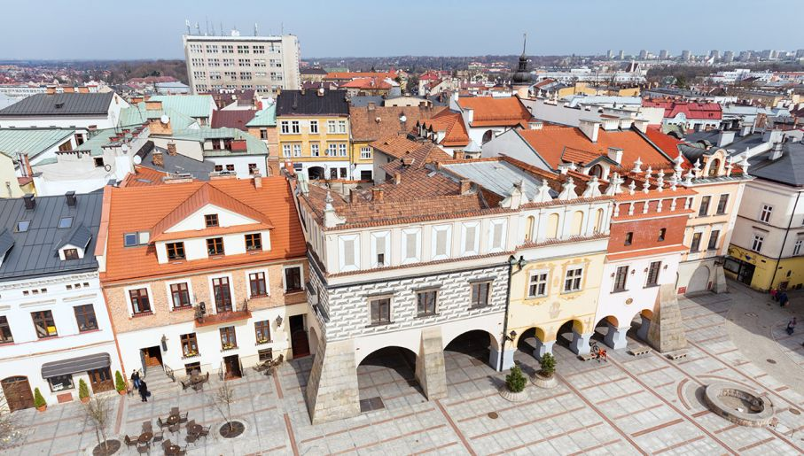

Slide 5
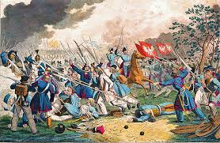
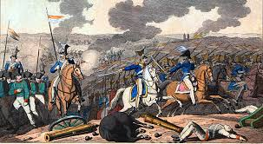
battle of Ostrołęka (1831)
The Battle of Ostrołęka of 26 May 1831 was one of the largest engagements of Poland's November Uprising. Throughout the day, Polish forces under Jan Skrzynecki fought for the control over the town of Ostrołęka against the assaulting Russian forces of Hans Karl von Diebitsch. Although by the end of the day the town was still in Polish hands and the two sides suffered comparable losses, the battle is usually considered a Polish defeat because of the Russian army's almost unlimited strategic reinforcement capability. The Polish Army could not similarly replenish its casualties.

Slide 6
Bem in the battle
At 19:00, Lt. Col. Józef Bem and Henryk Dembiński manoeuvred to make the Russians think the Poles still had hidden behind the hills reserve forces which would cost Diebitsch dearly if he continued to advance. Bem's 4th Mounted Battery was so close to the Russian lines when they dismounted, that Bem had three Platoons use grenades and bullets and the last two used grapeshot. Silence prevailed until Bem ordered his cannons to fire at which time the entire Russian line of artillery responded. This lasted for about half an hour during which time Bem fired two hundred and fifty times. The effect of Bem's "terrible shots" was to cut out the ranks of grenadiers in the streets, and the impression on Diebitsch was enough that he withdrew most of his troops from the bank of the Narew under cover of darkness

Slide 7
1848-1849 winter fight
In the past, the Polish troops freed the Hungarian units.
He was entrusted with the defence of Transylvania at the end of 1848, and in 1849, as General of the Székely troops, he performed miracles with his little army, notably at the bridge of Piski on February 9, where, after fighting all day, he drove back an immense force of pursuers.

Slide 8
Koszonjuk a figyelmet! Dziękujemy za uwagę! Thanks FOR your attention!
Barbara Babarczy, Lotti Kovacs, Kamil Kopczacki, Krystian Motyka

