Slide 1
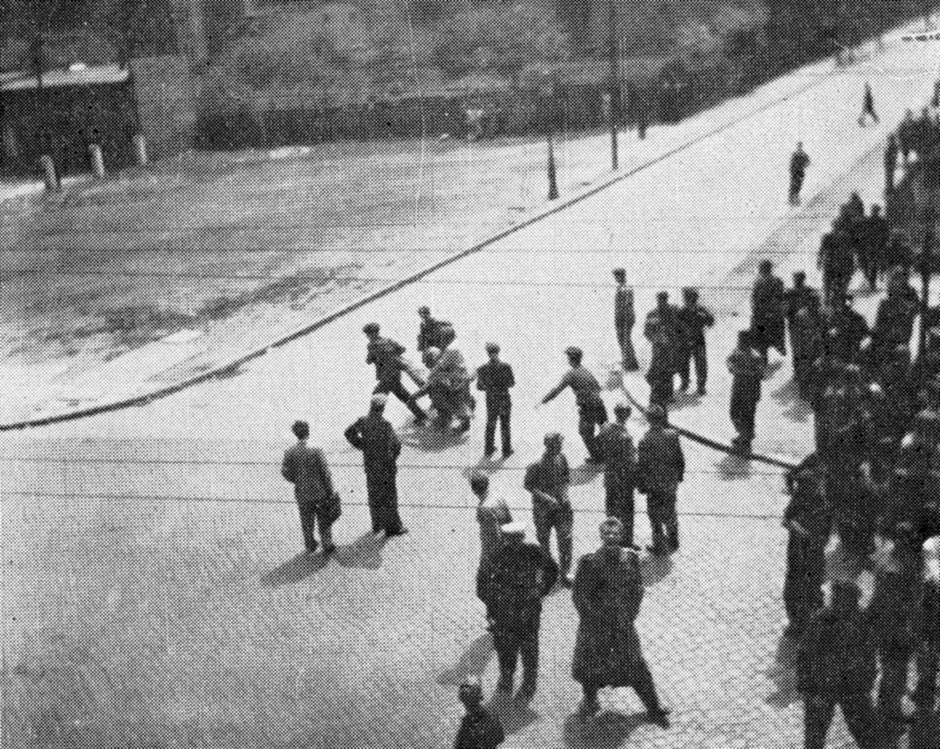
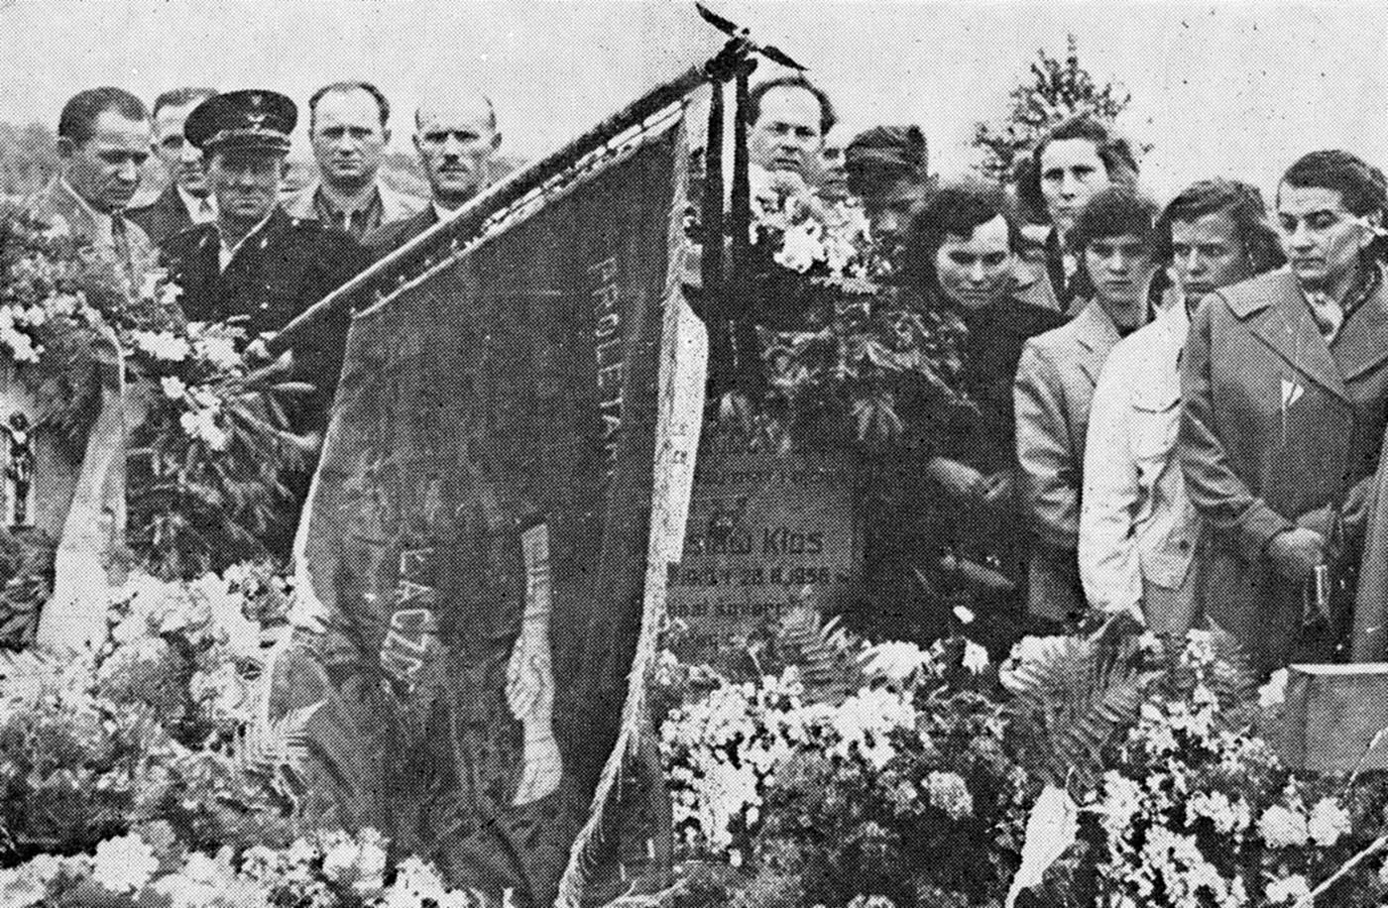
Poznan, 1956
It was the first strong massive protest against the communist government in Poland. They wanted better life and better lifestyle. During the Hungarian revolution the Poland govenment sent medical support, medicines and doctors as well. This prostest was important milestone on the way to the Polish October, the installion of a less Soviet-controlled government.

Slide 2
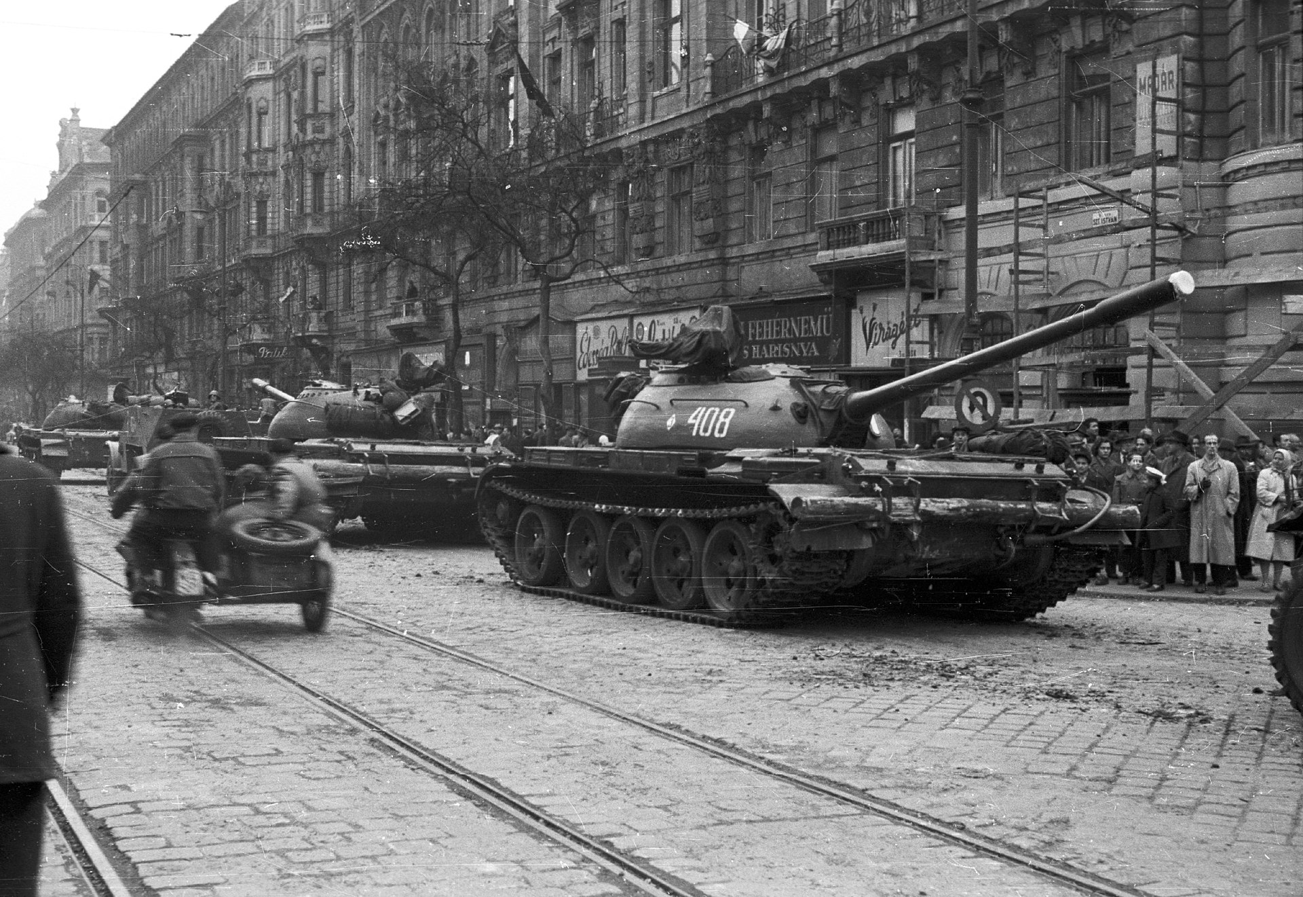
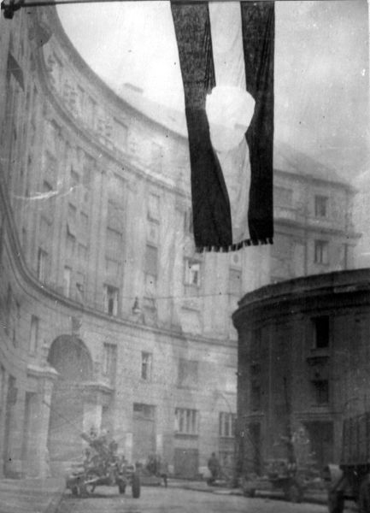
Hungarian Revolution of 1956
It was a fight against the soviet union. First it was a peacful protest, and then became a bloody fight. More than 3.000 people died in the fights, and more than 13.000 had injured. They tried several times to have a conference about it, to retreat all of the russian forces.

Slide 3
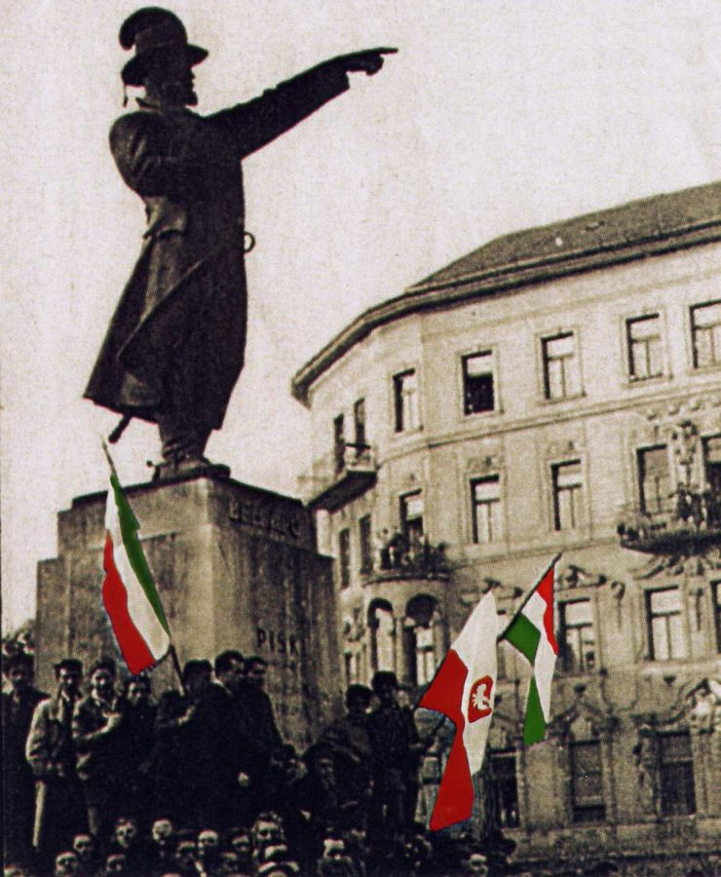
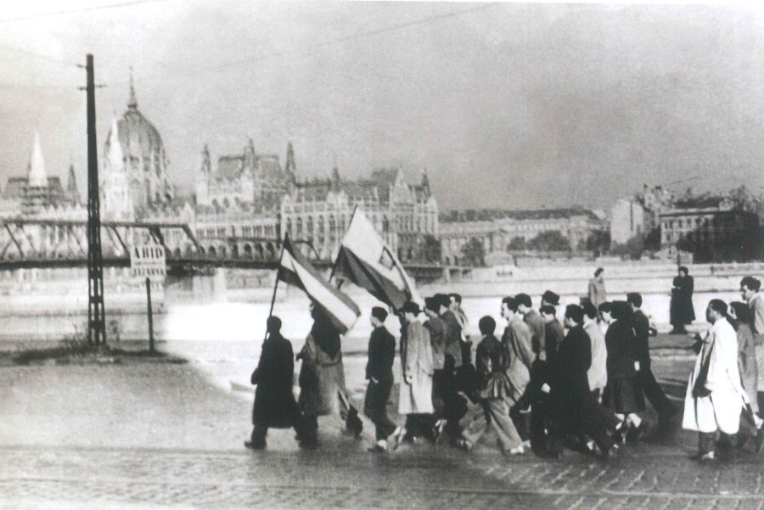
Common things
„Polak Węgier dwa bratanki”, they proved it then, as many times in the common history of the two countries. They send medicines, they collect money for the Hungarian revolution, and next to these facts, they encouraged us.

Slide 4
Thanks for your attention
Dziękujemy za uwagę
Jakub Olszański, Jakub Zięba,
Gyarmati Hanna, Szabo-Deak Laszlo

