Slide 1
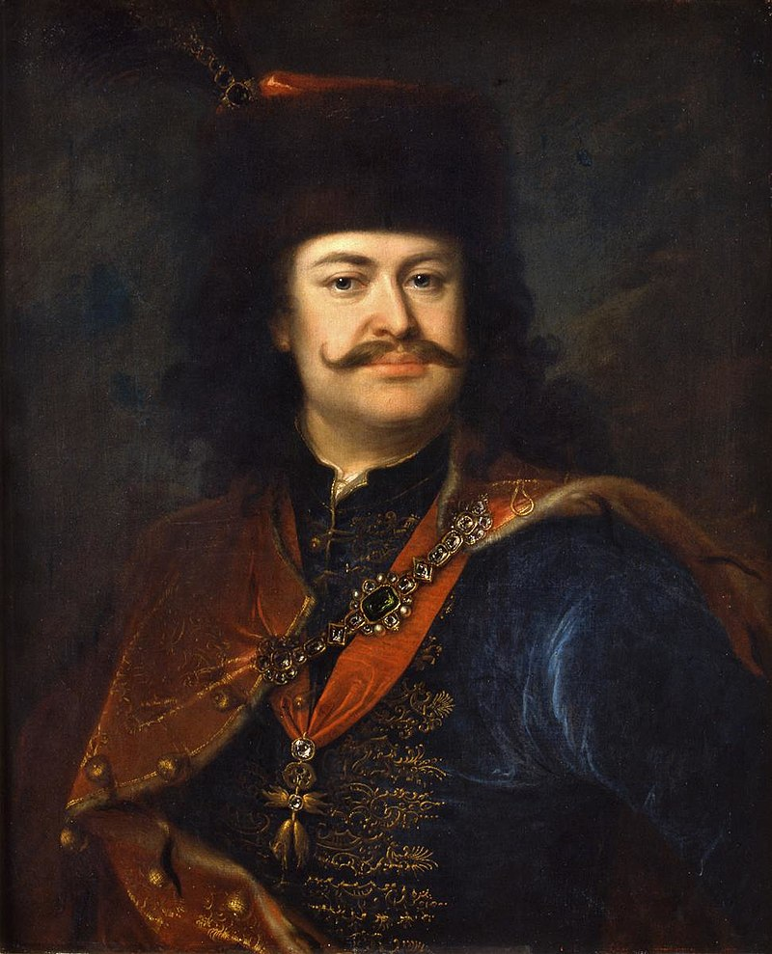
II.Rakoczi Ferenc
Francis II Rákóczi (Hungarian: II. Rákóczi Ferenc, Hungarian pronunciation: [ˈraːkoːt͡si ˈfɛrɛnt͡s]; 27 March 1676 – 8 April 1735) was a Hungarian nobleman and leader of the Hungarian uprising against the Habsburgs in 1703-11 as the prince (fejedelem) of the Estates Confederated for Liberty of the Kingdom of Hungary. He was also Prince of Transylvania, an Imperial Prince, and a member of the Order of the Golden Fleece. Today he is considered a national hero in Hungary.

Slide 2
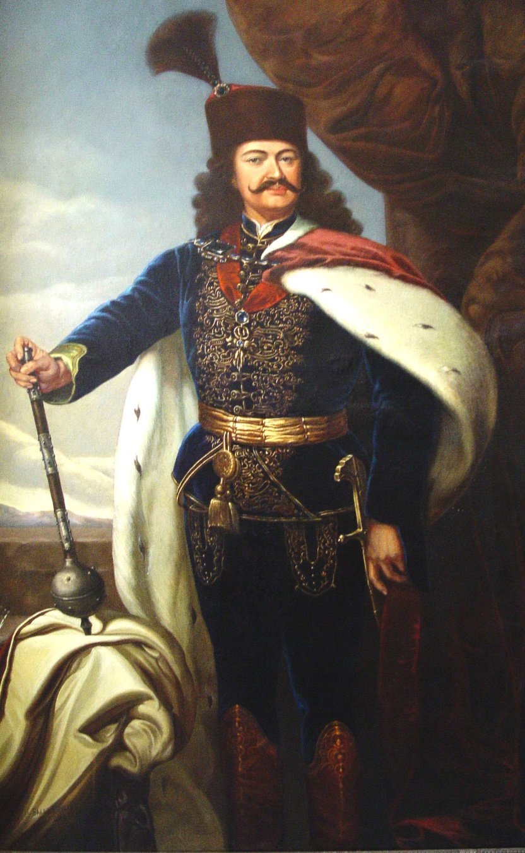
November 1701 II. Ferenc Rákóczi escaped from the prison in Vienna, fled to Poland. He lived in Krakow and Warsaw, and his partner was Miklós Bercsényi. When he returned home in 1703, the Poles also helped, including Prince Stanisław Leszczyński, against whom Peter Tsar of Russia, Rákóczi, wanted to help the Polish royal throne.

Slide 3
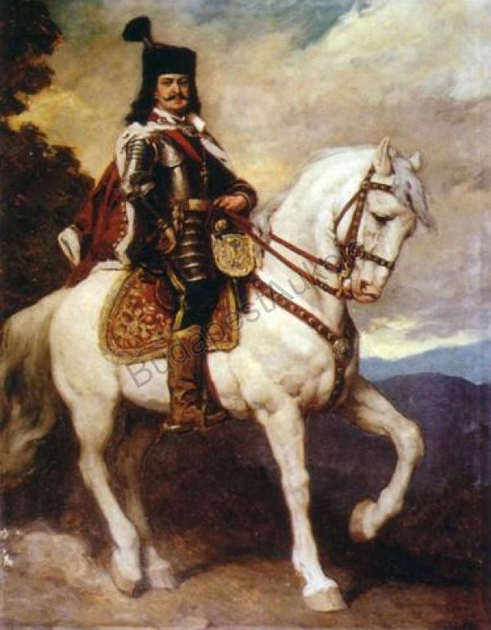
After the expulsion of the Turks, the Kuruc rebel forces of Hungary, wholly under Habsburg rule, were able to find shelter in Poland, similarly to the political refugees of previous times. Thanks to the relationship between János Sobieski and Imre Thököly, the Polish land could be a safe haven for them.

Slide 4
The relationship between the Hungarians and the Poles is very strong throughout history, from the age of the Árpád to the present. Strong relationships are also confirmed by a saying: Polish, Hungarian - two friends, fighting together and drinking wine. ("Polak, Węgier, dwa bratanki, i do szabli, i do szklanki.")

Slide 5
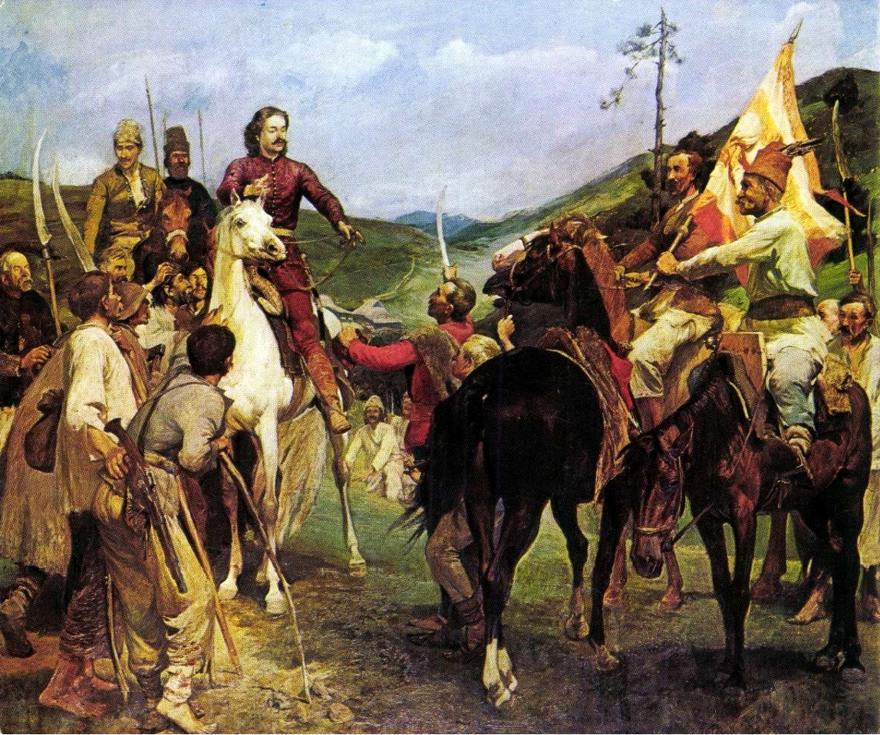
Rakoczi uprising - anti-Habsburg insurrection in Hungary in 1703-1711, initiated and led by the magnate Franciszek II Rakoczy.

Slide 6
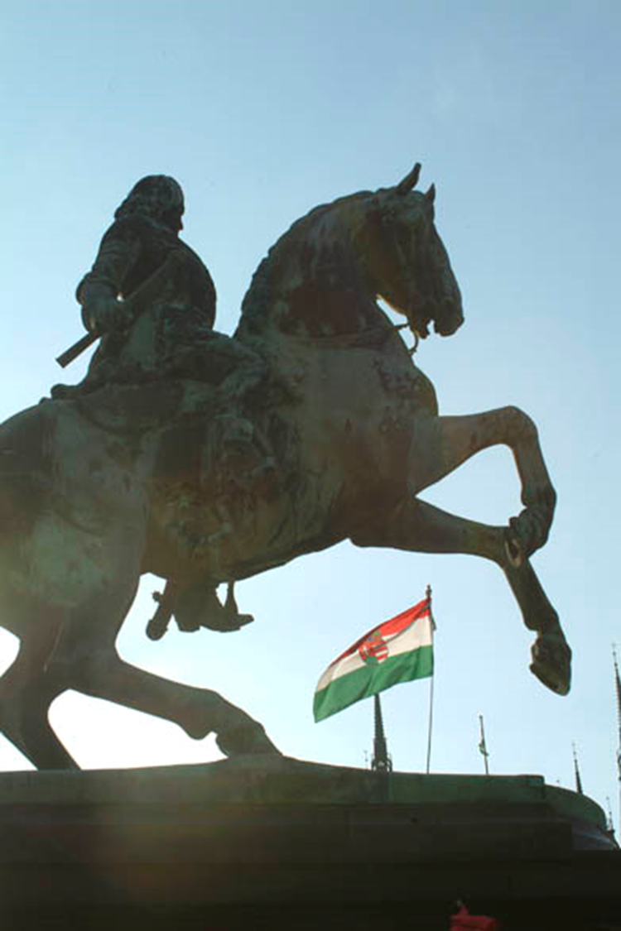
International relations provided Hungary with an opportunity to liberate themselves from the Habsburgs. With the help of Louis XIV of France anti-Habsburg rebels, led by a young nobleman, Imre Thököly rose against the Empire in 1678. Thököly occupied most of Northern Hungary. In 1681 the Ottomans joined to help him, and Thököly was recognised as King of Upper Hungary by Sultan Mehmed IV. However, when the Ottomans lost the battle of Vienna in 1683, Thököly lost Ottoman support and was eventually defeated in 1685. His alliance with the Ottomans changed the positive perception Western Europe had about Hungary, and instead of being thought of as the bastion of Christianity, the country was now being thought of as an enemy, partly as a consequence, Hungary was occupied and organised as "newly acquired territory" instead of "territory liberated from the Ottomans".

Slide 7
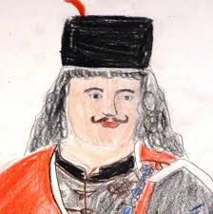
Made by:
Potvorszki Csilla
Toth Petra
Fila Kacper
Kantor Adrian
Rakoczi Ferenc

