Slide 1
II.Rakoczi Ferenc
Authors:
Aranyi Petra
Balint Boglarka
Bartosz Chmielecki

Slide 2
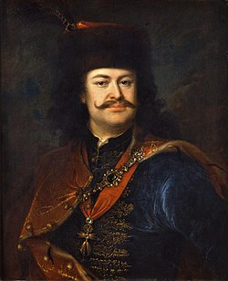
Quick biography
Francis II Rákóczi (Hungarian: II. Rákóczi Ferenc, Hungarian pronunciation: [ˈraːkoːt͡si ˈfɛrɛnt͡s]; 27 March 1676 – 8 April 1735) was a Hungarian nobleman[1] and leader of the Hungarian uprising against the Habsburgs in 1703-11 as the prince (fejedelem) of the Estates Confederated for Liberty of the Kingdom of Hungary. He was also Prince of Transylvania, an Imperial Prince, and a member of the Order of the Golden Fleece. Today he is considered a national hero in Hungary.

Slide 3
Childhood
He was the richest landlord in the Kingdom of Hungary and was the count (comes perpetuus) of the Comitatus Sarossiensis (in Hungarian Sáros) from 1694 on. He was the third of three children born to Francis I Rákóczi, elected ruling prince of Transylvania, and Zrínyi Ilona, who was the daughter of Zrínyi Péter, Ban of Croatia, and niece of the poet Zrínyi Miklós. His grandfather and great-grandfather, both called George, were Princes of Transylvania. He had a brother, George, who died as a baby before Francis was born, and a sister, Julianna Rákóczi, later Countess of Aspremont-Lynden, who was four years older than Francis. His father died when he was four months old.

Slide 4
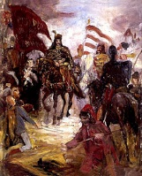
Role of Poland
One of the youngsters of the young master, accompanied by Ádám Berzeviczy, to Poland he was a refugee, where he found protection and a second home. But even here Rákóczi's life was in danger, mainly because HUF 10 000 bounty on his head, so I saw good cousin, Sieniawski Prince koronahetman wife, Elżbieta Lubomirski Duke women masked or obscured.

Slide 5
Exile
Rákóczi was offered the Polish Crown twice, supported by Tsar Peter I of Russia. He turned the offers down, though, and remained in Poland until 1712, where he was the honored guest of the Polish aristocracy. For a while he lived in Gdańsk under the pseudonym of Count of Sáros.

Slide 6
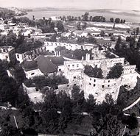
Proclamation of Breznai
1703 .May 12 dated II. Ferenc Rákóczi, prince of Transylvania, prince of German-roman empire, Hungarian nobleman and Miklós Bercsényi, published the “breznai proclamation” of „ Felső-Vadászi Rákóczi Ferenc Head and Gróff Székesi Bercsényi… ”. This call to arms edict three Hungarian-language copy of the memory of the first war of journalism, have survived Bercsényi handwriting, which Kalman Thaly discovered (the whole extent of the cathedral said Earl Bercsényi family, his work, entitled 1470-1835

Slide 7
Jarosław battle
1656 in liberating the country Stefan Czarniecki in Jaroslaw battle to beat the Swedes. In 1683 , he waited in the city for the victorious Battle of Kahlenberg and Cornwallreturning royal husband, wife of Queen Otties Sobieski , Queen of Mary. In the time of the Great Northern War, the King of Hungary, Ágos Erős and Tsar Nagy , went to the town , and Princess Sarolta II lived here for years , II. Ferenc Rákóczi's wife. In 1711 , after the defeat of the War of Independence II. Ferenc Rákóczi and Miklós Bercsényi stayed in the town for a long time and negotiated with Peter I of Russia . Jarosław was the center of the Kuruc emigrants , so the monument of Polish-Hungarian friendship is also here .

